Slide 1
Adapting Worksheets
This contains examples of common ways to adapt worksheets for students.
These examples can be used across grade levels.
These worksheets can help you generate ideas that will help provide access for your students, decrease unnecessary demands, and help with behaviors.

Slide 2
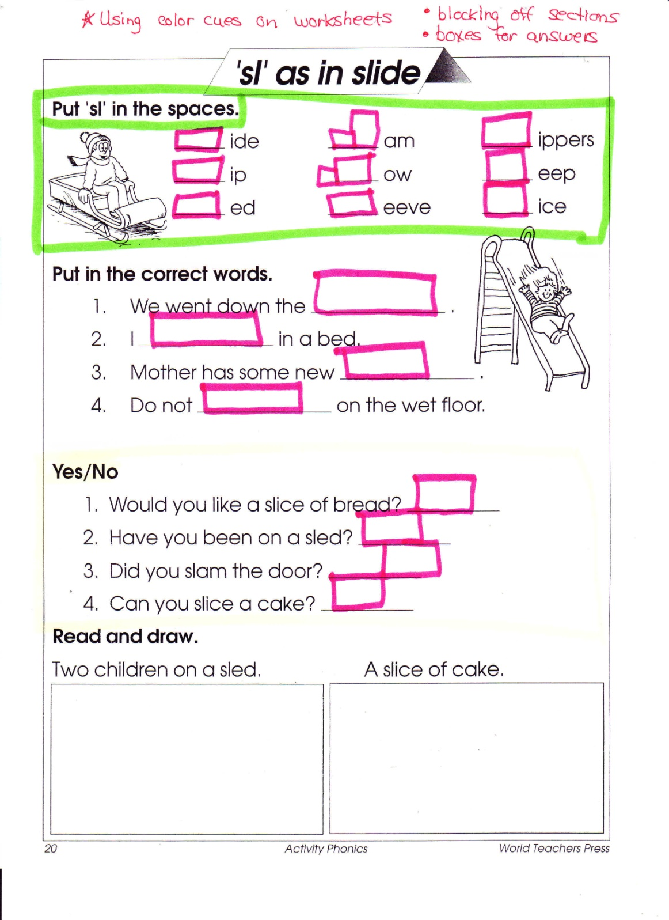

Slide 3
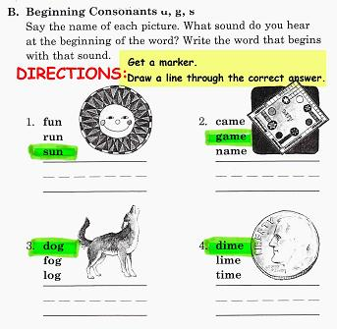

Slide 4
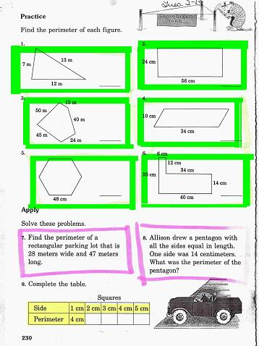

Slide 5
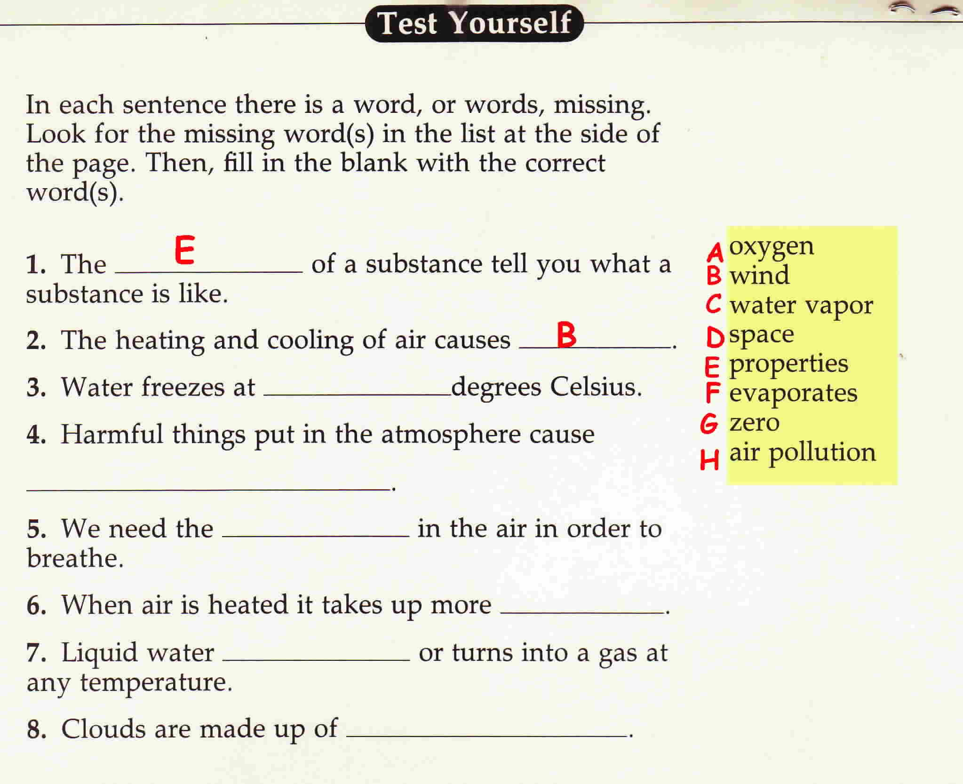
Modified Worksheets

Slide 6
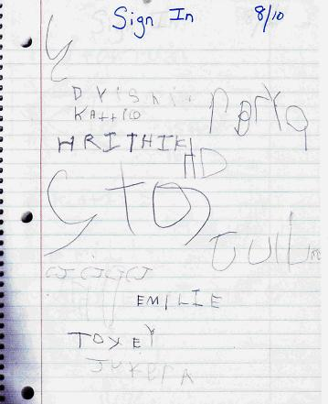
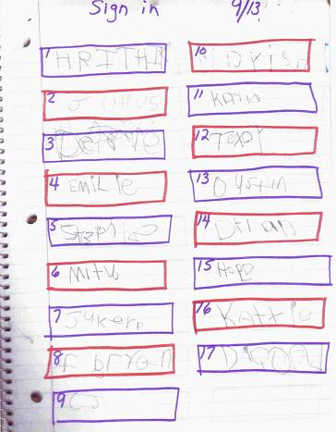

Slide 7
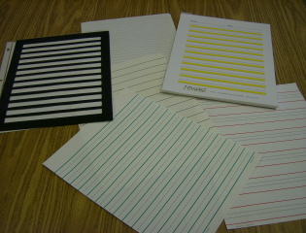
Specialty Paper

Slide 8
This specialty paper has the bold color cueing the student.

Slide 9
This paper has a raised line to cue the student with a tactile border.

Slide 10
This is a special handwriting paper with visual cues for starting and stopping. Good for beginning writers.

Slide 11
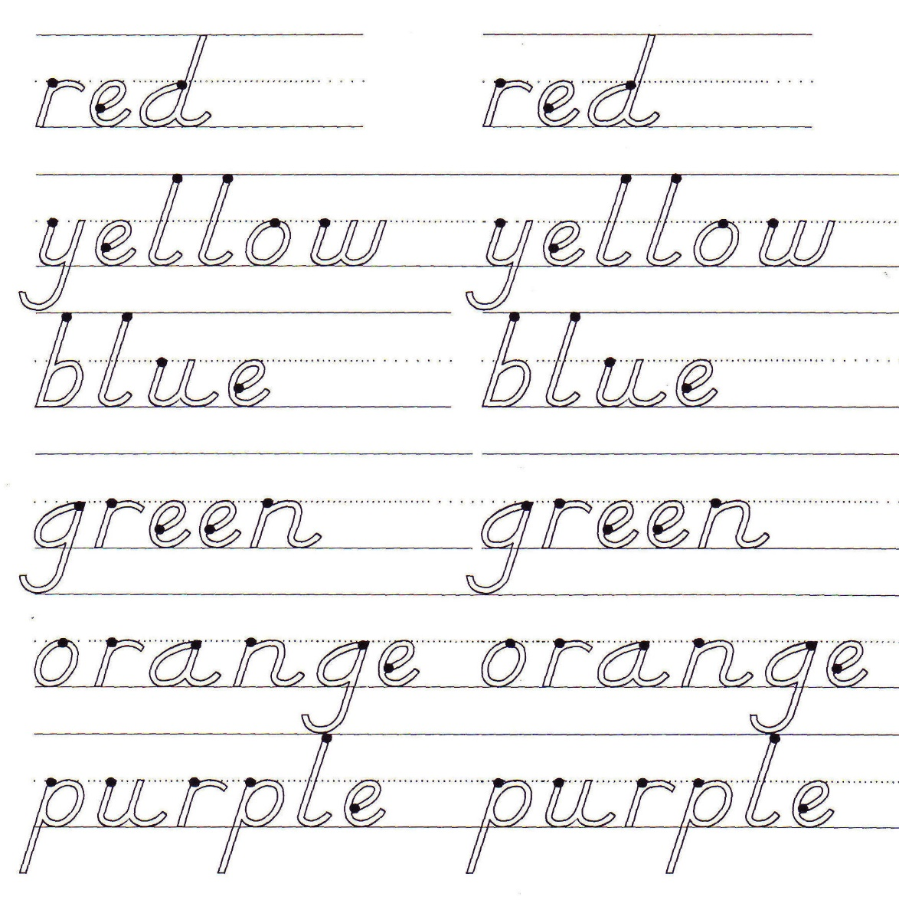
Sample worksheet
The font is the non-traditional (D’Nealian) with dots to cue where to start.

Slide 12
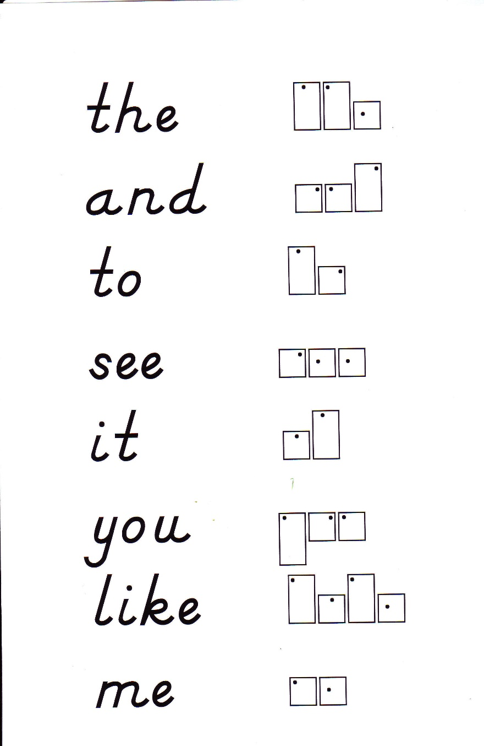
Sample of Configuration

Slide 13
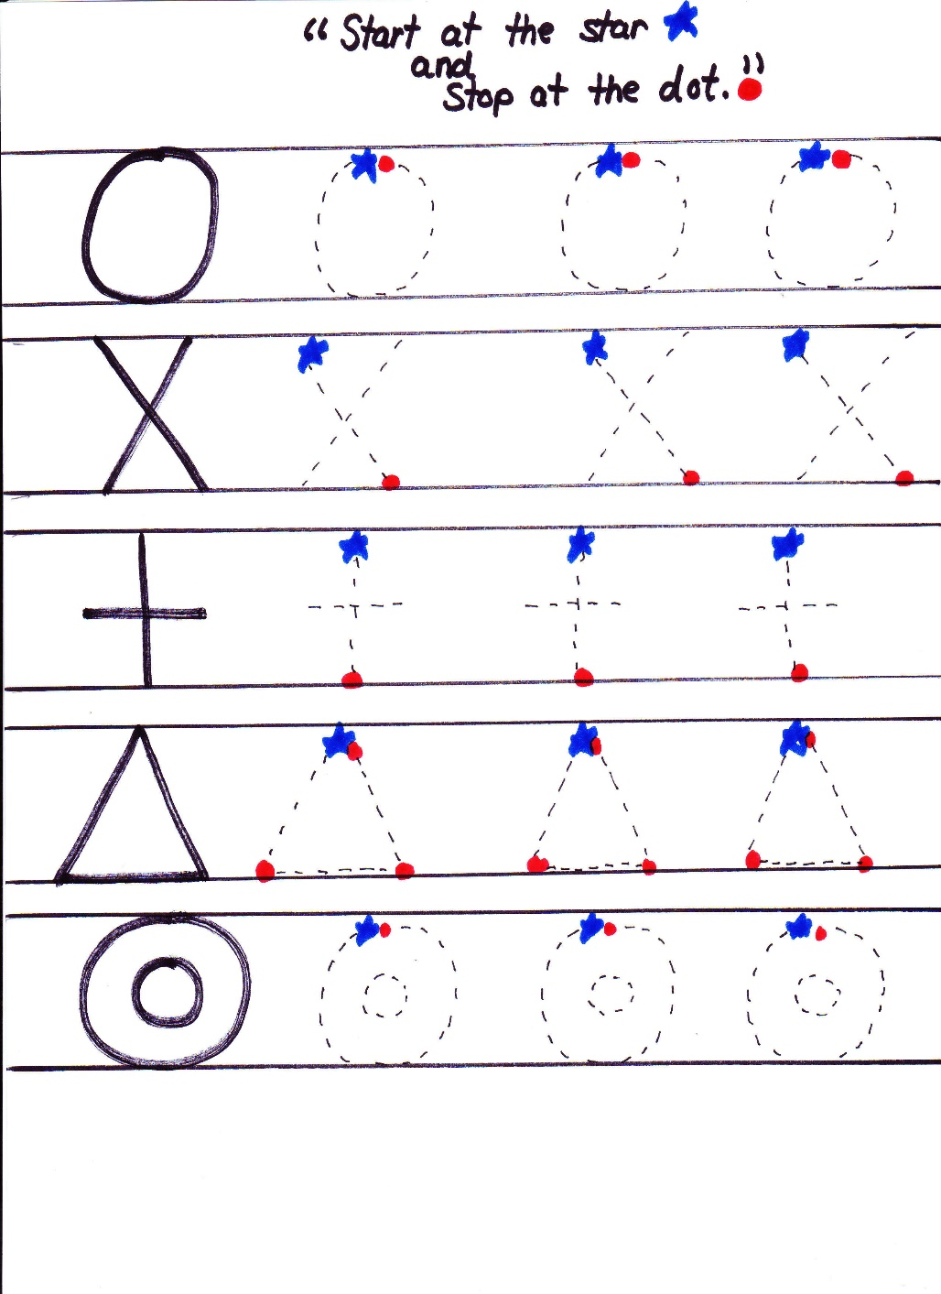
Using color cues to start and stop.

Slide 14
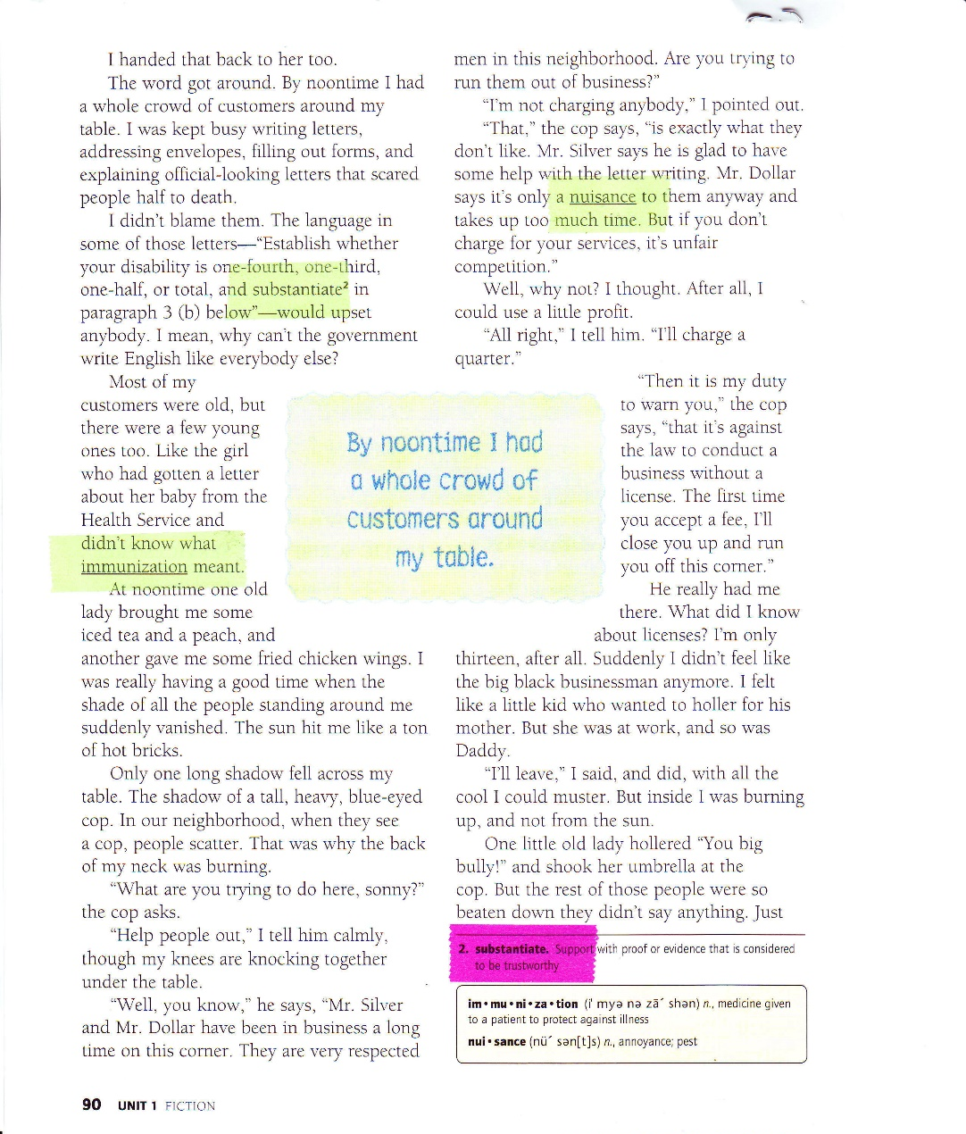
Highlight tape can be used on worksheets and in textbooks. The tape brings attention to the words and is easily removed from the paper without tearing the page.

Slide 15
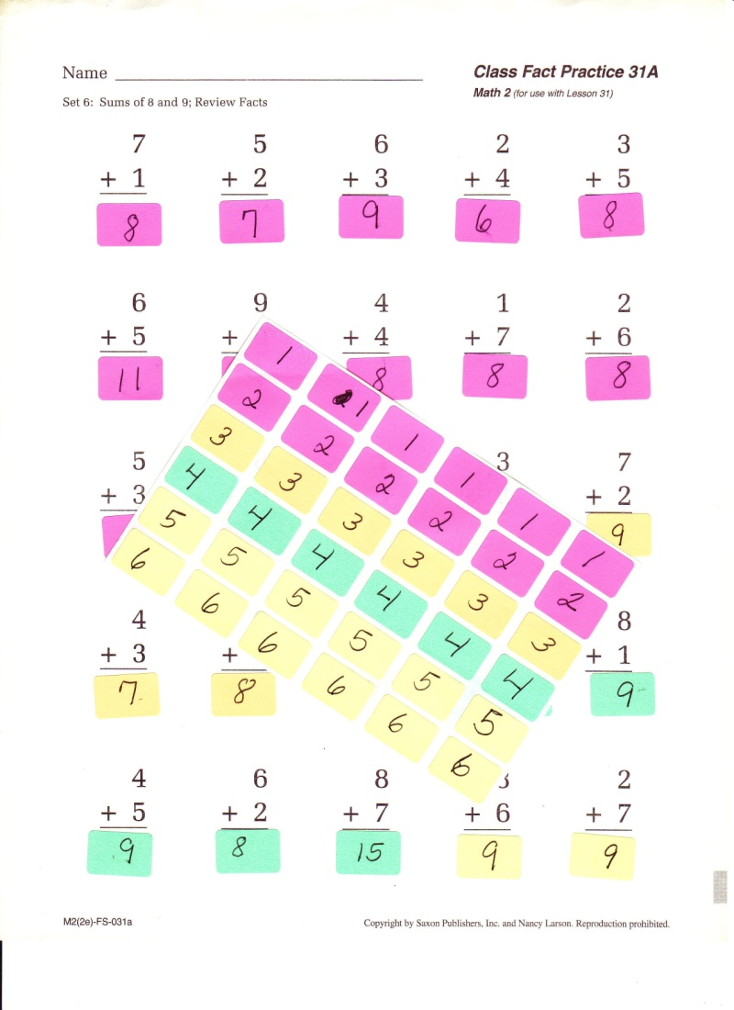
Using stickers for answers

Slide 16
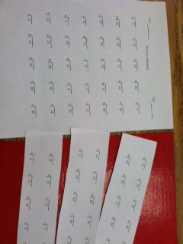
Presentation of worksheet

Slide 17
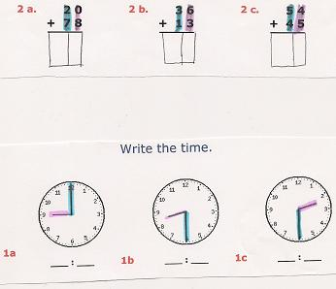

Slide 18
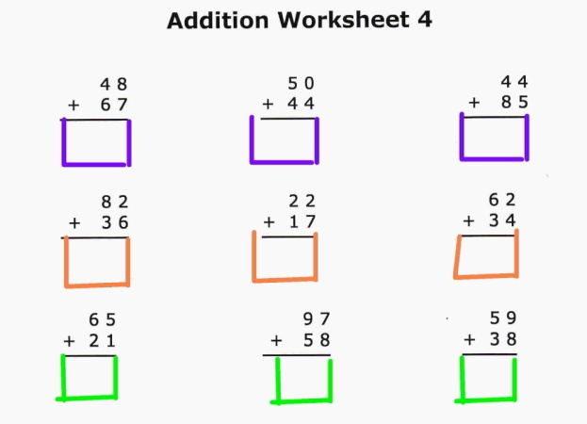
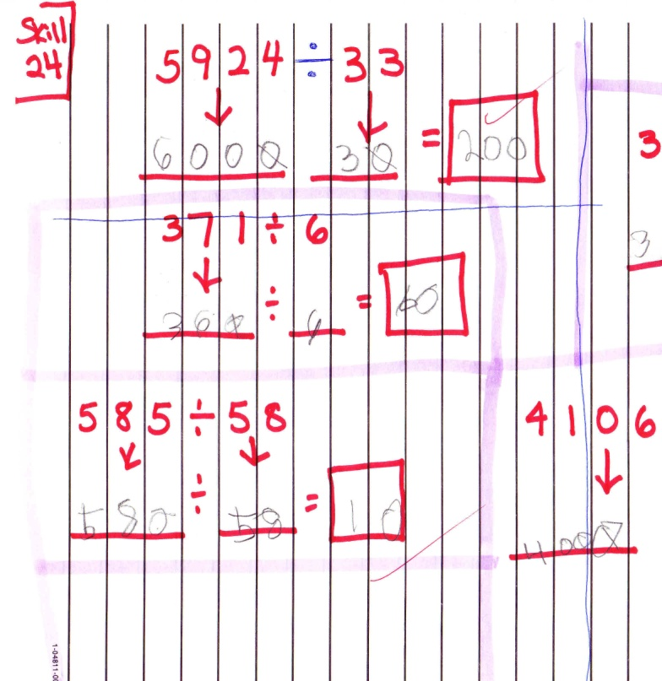
Low Tech Math Solutions

